Slide 1
Communication Preferences for Fairlington Meadows Related Information
Monday, November 11, 2019

Slide 2
140
Total Responses
Date Created: Sunday, September 08, 2019
Complete Responses: 140

Slide 3
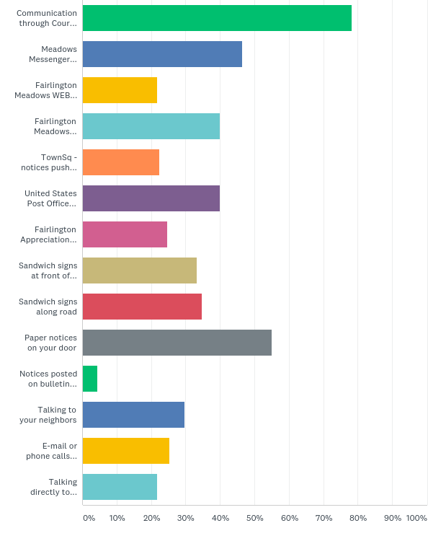
Q1: How do you currently receive information from the Fairlington Meadows board, Fairlington Meadows committees, and CMC? (select all methods that apply)
Answered: 138 Skipped: 2

Slide 4
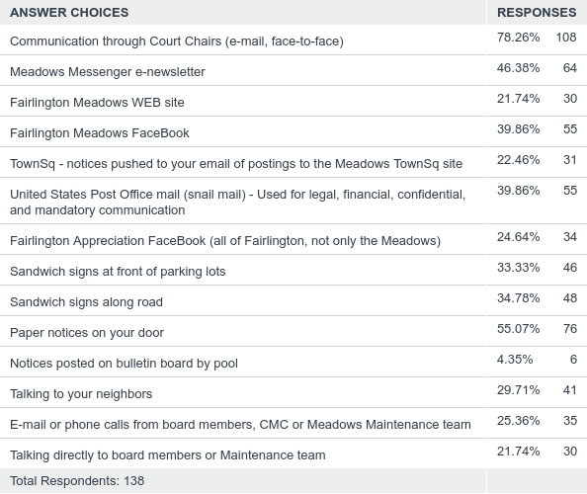
Q1: How do you currently receive information from the Fairlington Meadows board, Fairlington Meadows committees, and CMC? (select all methods that apply)
Answered: 138 Skipped: 2

Slide 5
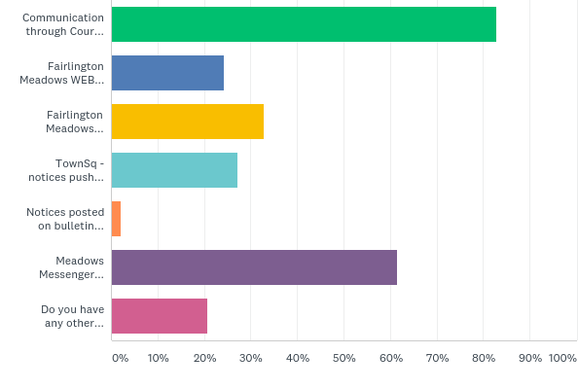
Q2: Select the top 3 methods you prefer to receive information from Fairlington Meadows board and committees
Answered: 140 Skipped: 0

Slide 6
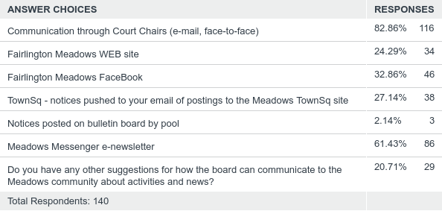
Q2: Select the top 3 methods you prefer to receive information from Fairlington Meadows board and committees
Answered: 140 Skipped: 0

Slide 7
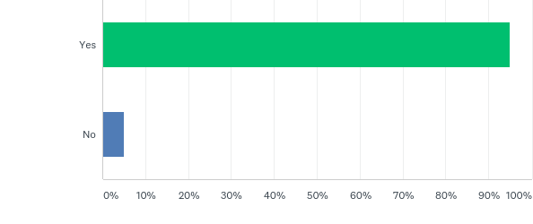
Q3: Do you like the Meadows Board using surveys to gather resident opinions on matters concerning our community?
Answered: 140 Skipped: 0

Slide 8
Q3: Do you like the Meadows Board using surveys to gather resident opinions on matters concerning our community?
Answered: 140 Skipped: 0

Slide 9
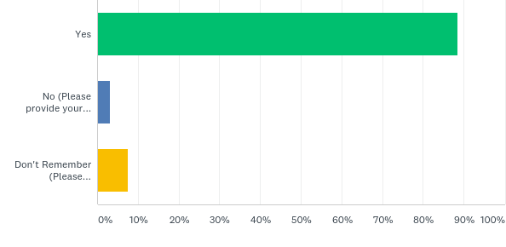
Q4: Did you receive notice of electronic Proxy Voting for the Annual Meeting from Fairlington Meadows this year? (Applies to owners only)
Answered: 131 Skipped: 9

Slide 10
Q4: Did you receive notice of electronic Proxy Voting for the Annual Meeting from Fairlington Meadows this year? (Applies to owners only)
Answered: 131 Skipped: 9

Slide 11
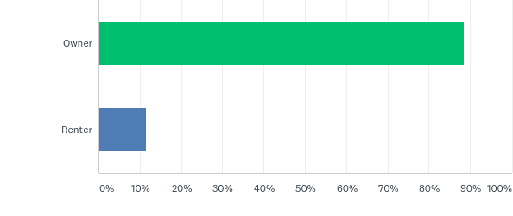
Q5: Are you a renter or owner
Answered: 140 Skipped: 0

Slide 12
Q5: Are you a renter or owner
Answered: 140 Skipped: 0

Slide 13
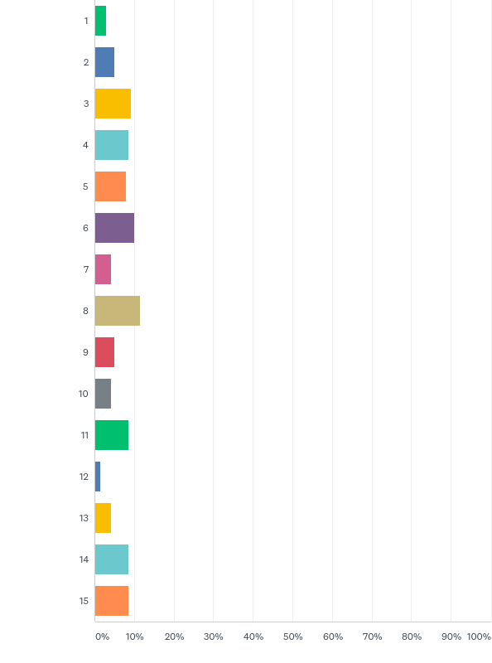
Q6: What court do you live in?
Answered: 140 Skipped: 0

Slide 14
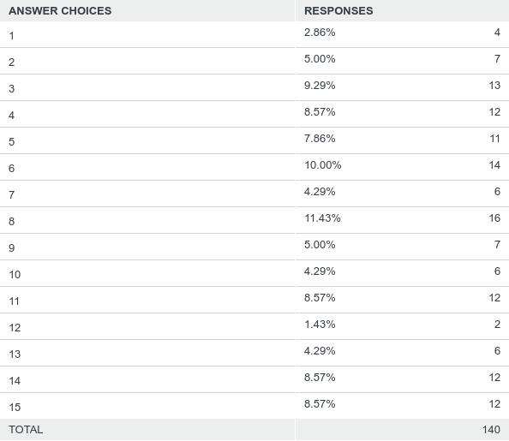
Q6: What court do you live in?
Answered: 140 Skipped: 0

